Slide 1
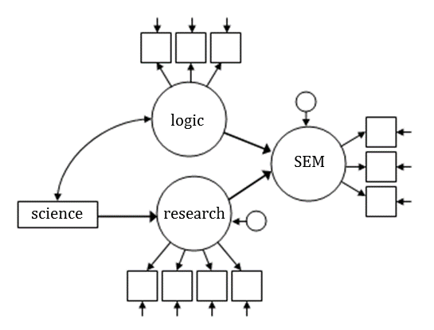

Intro to SEM with examples from Stata and Mplus
Christiane Grill Nate Breznau
Mannheim Centre for European Social Research
Social Science Data Lab
29.11.2017

Slide 2
What is SEM
Structural – human built, constructed
Equation
a logical statement (“=”)
a mathematical statement (5x=2y)
statistical in some way

Slide 3
What is SEM
Structural – human built, constructed
Equation
a logical statement (“=”)
a mathematical statement (5x=2y)
statistical in some way
Structural Equation – one equation dependent on others
Models – descriptions of theory in mathematical terms

Slide 4
What is SEM
Anti-immigrant attitudes
Culture: value of cultural diversity
Contact with immigrants
Model 1. Same Variables. Alternative Models.
(a) (b)
(c) (d)
Culture
Culture
Anti
Anti
Contact
Contact
Culture
Culture
Anti
Anti
Contact
Contact

Slide 5
What is SEM
Anti-immigrant attitudes
Culture: value of cultural diversity
Contact with immigrants
Model 1. Same Variables. Alternative Models.
(a) (b)
(c) (d)
Culture
-0.74
Culture
-0.73
0.25
Anti
0.25
Anti
Contact
-0.24
Contact
-0.06
Culture
-0.73
Culture
-0.74
0.25
Anti
0.20
Anti
Contact
-0.06
Contact
Mplus Code: M1a; M1b; M1c; M1d

Slide 6
What is SEM
Anti-immigrant attitudes
Culture: value of cultural diversity
Contact with immigrants
Model 1. Same Variables. Alternative Models.
(a) (b)
(c) (d)
Culture
-0.74
Culture
-0.73
0.25
Anti
0.25
Anti
Contact
-0.24
Contact
-0.06
Structural coefficient!
E(Culture)|Contact, Contact ⊥ Anti
Culture
-0.73
Culture
-0.74
0.25
Anti
0.20
Anti
Contact
-0.06
Contact
Code: fig1a; fig1b; fig1c; fig1d

Slide 7
What is SEM

Slide 8
What is SEM
264 Models with 4 variables;
11,664 with 5!

Slide 9
Surprising but True. SEM…
…is analysis of covariance structures
…does not minimize error terms
…cannot identify causality
…requires qualitative assumptions
…’s structural coefficients ≠ regression coefficients
…any model can eventually fit the data perfectly
(Bollen 1989; Bollen and Pearl 2013)

Slide 10
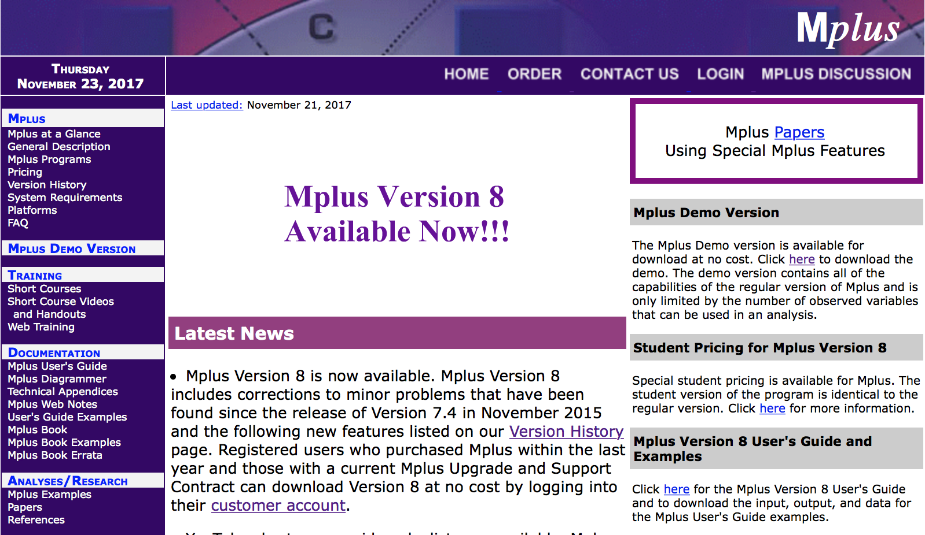
MPLUS
www.statmodel.com

Slide 11
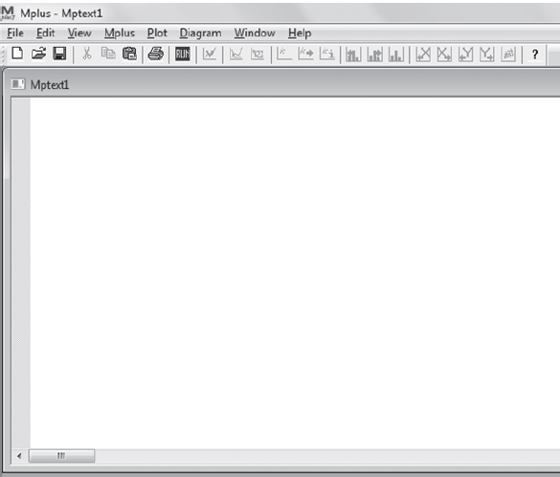
MPLUS
Mplus editor
Mplus input file: *.inp
Mplus output file: *.out
Input data file: *.dat
Define missings!
Other software runs Mplus
runmplus (Stata)
MplusAutomation (R)

Slide 12
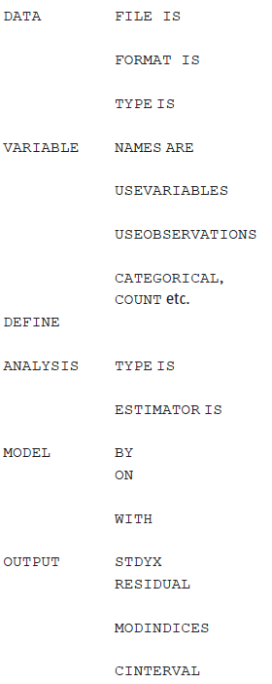
MPLUS Syntax
Command block Options
Command block Options

Slide 13
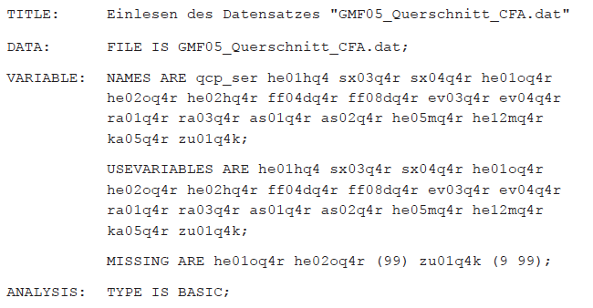
MPLUS Syntax

Slide 14
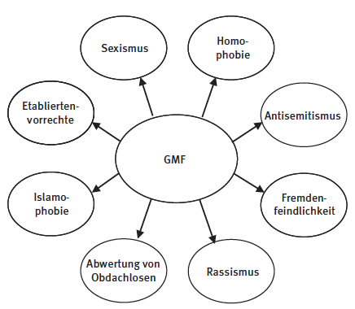
Factor Analysis
(Kleinke et al 2017: Figure 2.1)

Slide 15
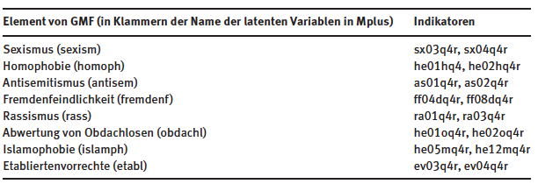
Factor Analysis

Slide 16
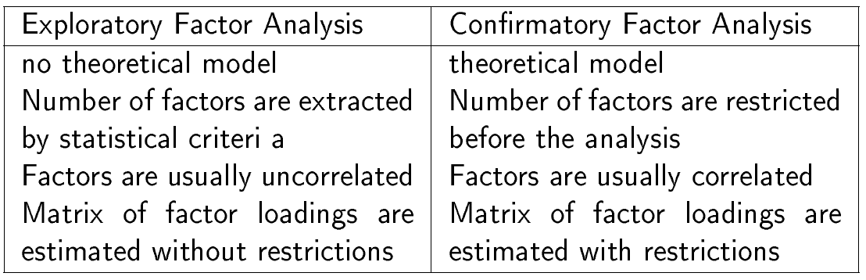
Factor Analysis

Slide 17
Exploratory Factor Analysis
Exploratory factor analysis (EFA) is used to determine the number of continuous latent variables that are needed to explain the correlations among a set of observed variables.
The continuous latent variables are referred to as factors, and the observed variables are referred to as factor indicators (manifest variables). In EFA, factor indicators can be continuous, censored, binary, ordered categorical (ordinal), counts, or combinations of these variable types.

Slide 18
Exploratory Factor Analysis
Two main questions can be answered with exploratory factor analysis:
How many factors are needed to explain the associations between the measurements (manifest variables)?
How strong are the relationships between the factors and the measurements (manifest variables)?

Slide 19
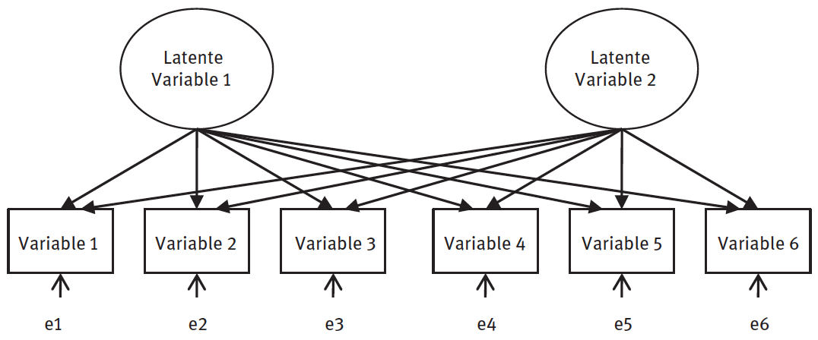
Exploratory Factor Analysis
latent variable 1
latent variable 2
(Kleinke et al 2017: Figure 2.2)

Slide 20
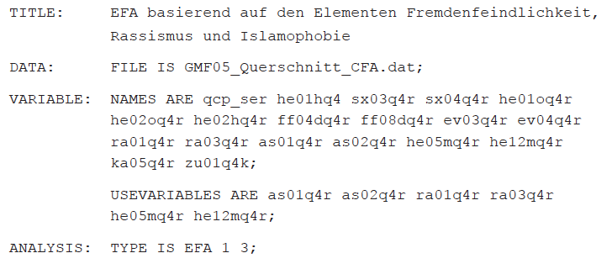
Exploratory Factor Analysis
Note: oblique rotation of geomin per default
Specification of rotation:
ANALYSIS: ROTATION = GEOMIN (OBLIQUE, .5);
ANALYSIS: ROTATION = CF-VARIMAX (ORTHOGONAL);
Code: M2, taken from Kleinke (et al 2017).

Slide 21
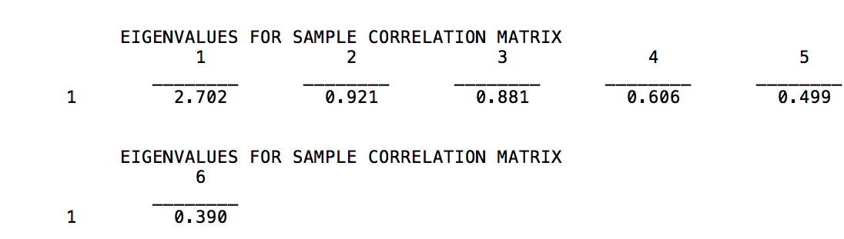
Exploratory Factor Analysis
Model 2. Results for Exploratory Factor Analysis
Code: M2, taken from Kleinke (et al 2017).

Slide 22
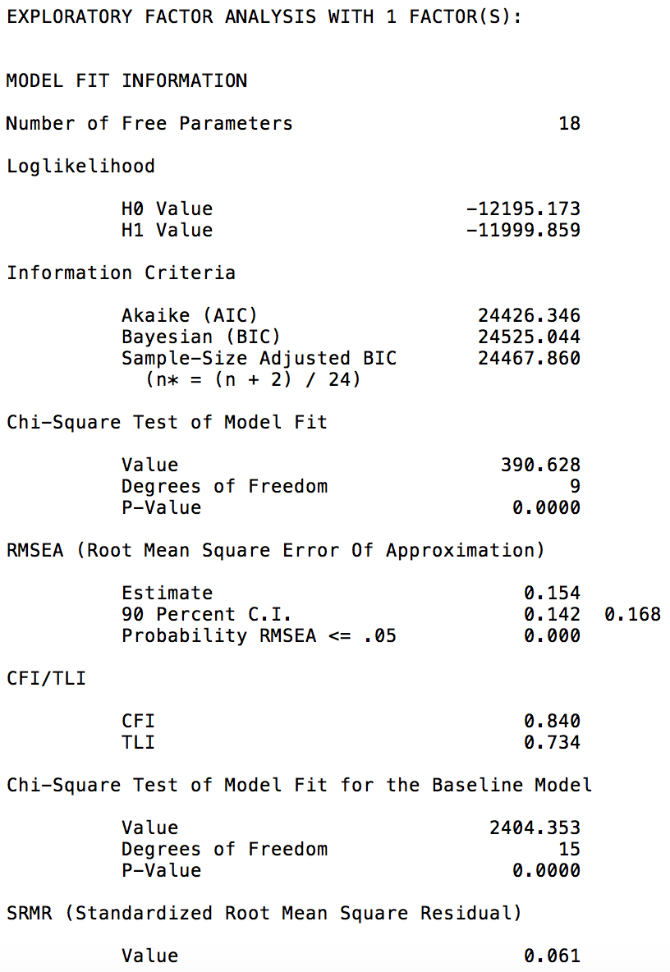
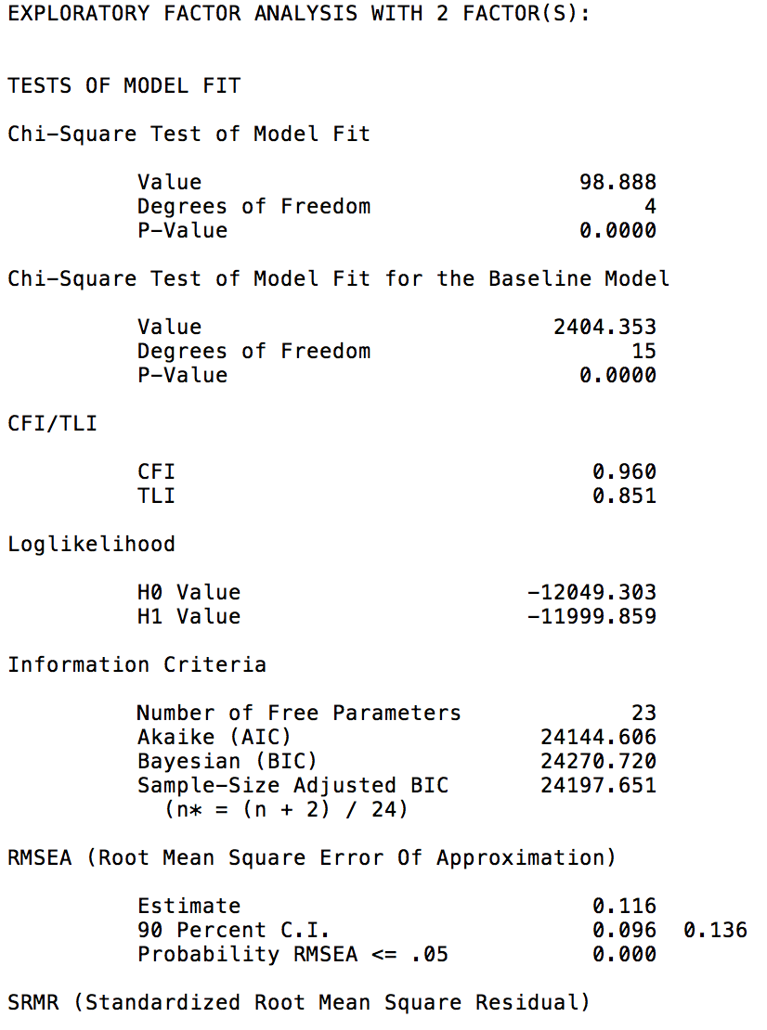
Exploratory Factor Analysis

Slide 23
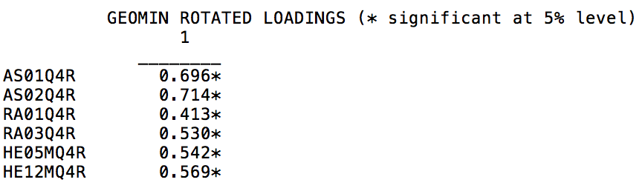
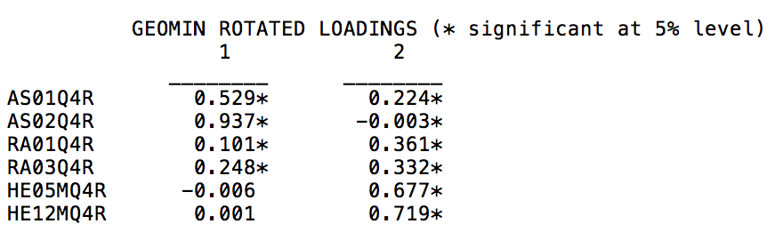
Exploratory Factor Analysis
Jews have too much influence
Jews responsible for own persecution
German ancestry immigrants should be better off than others
White people should rule the world
Muslims make me feel like a stranger
Muslims should be prohibited

Slide 24
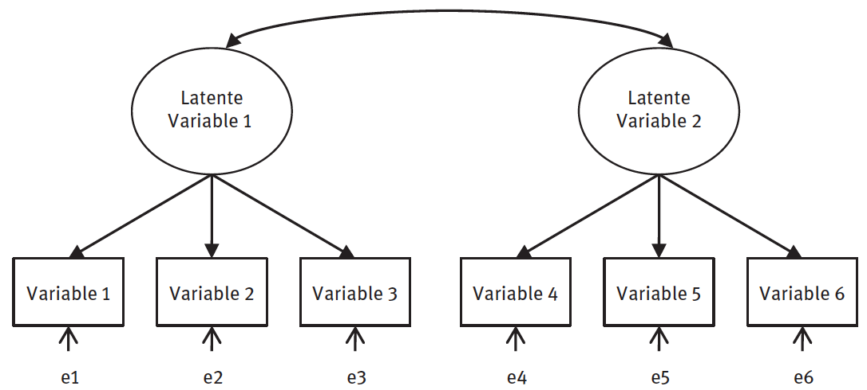
Confirmatory Factor Analysis
latent variable 1
latent variable 2
(Kleinke et al 2017: Figure 2.3)

Slide 25
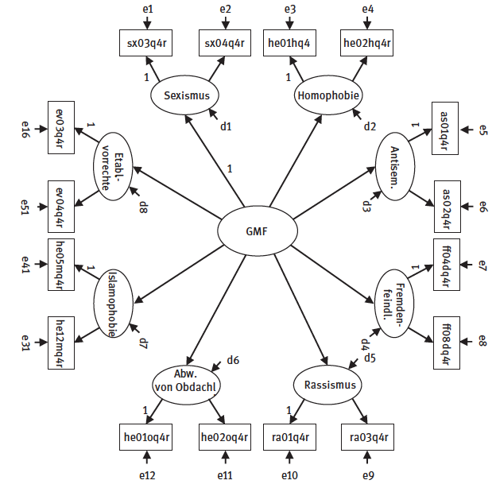
Confirmatory Factor Analysis
(Kleinke et al 2017: Figure 2.4)

Slide 26
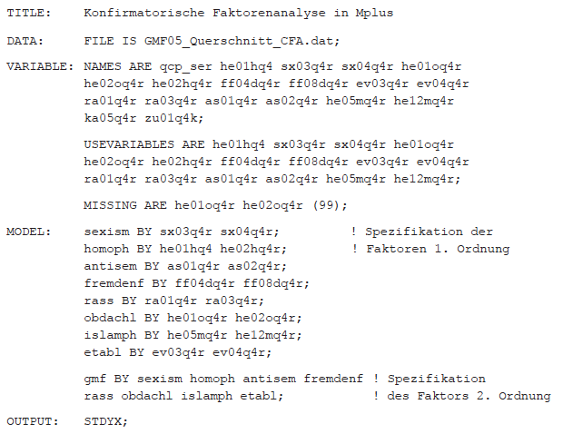
Confirmatory Factor Analysis
Model 3. CFA
Code: M3, taken from Kleinke (et al 2017).

Slide 27
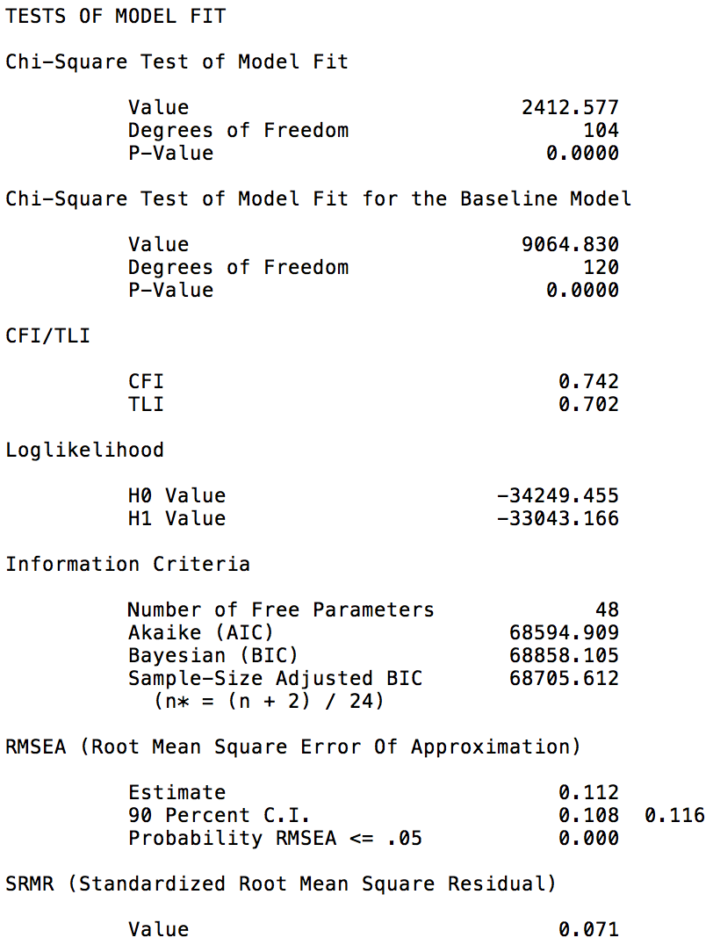
Confirmatory Factor Analysis
Code: M3, taken from Kleinke (et al 2017).

Slide 28
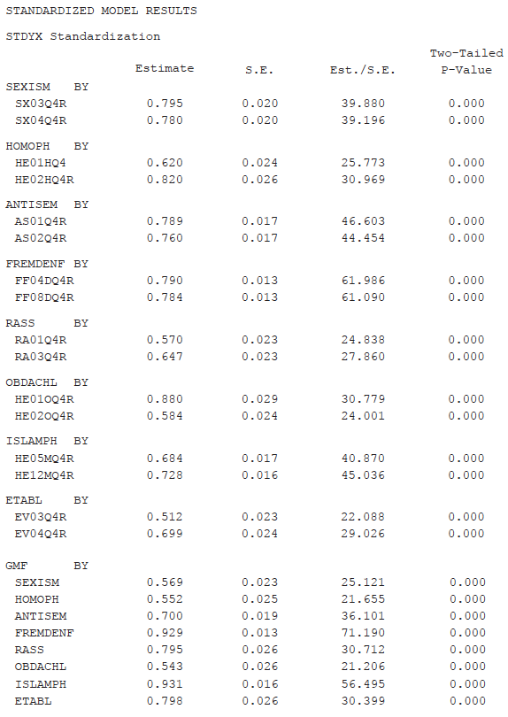
Confirmatory Factor Analysis
Model 3. Results for Confirmatory Factor Analysis, STDYX
Code: M3, taken from Kleinke (et al 2017).

Slide 29
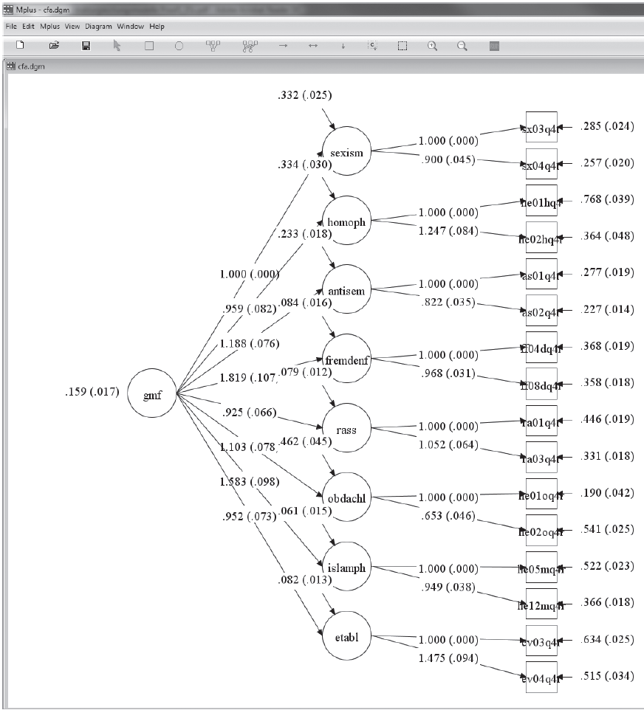
MPLUS Diagrammer

Slide 30
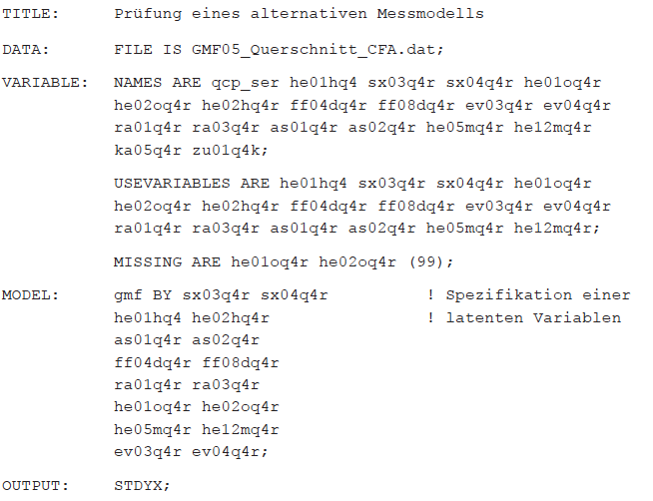
Confirmatory Factor Analysis
Model 4. Alternative CFA
Code: M4, taken from Kleinke (et al 2017).

Slide 31
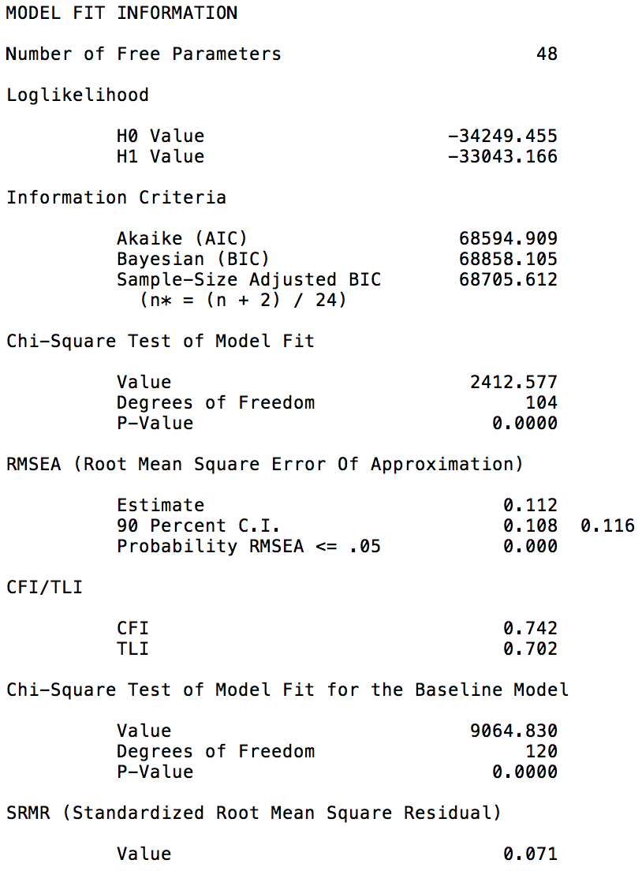
Confirmatory Factor Analysis
Model 4. Alternative CFA
Code: M4, taken from Kleinke (et al 2017).

Slide 32
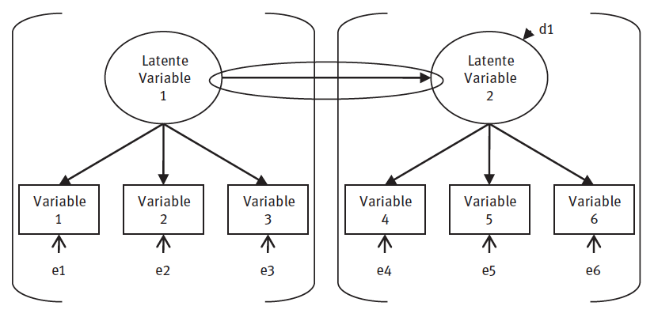
Structural Equation Model
latent variable 1
latent variable 2
(Kleinke et al 2017: Figure 3.1)

Slide 33
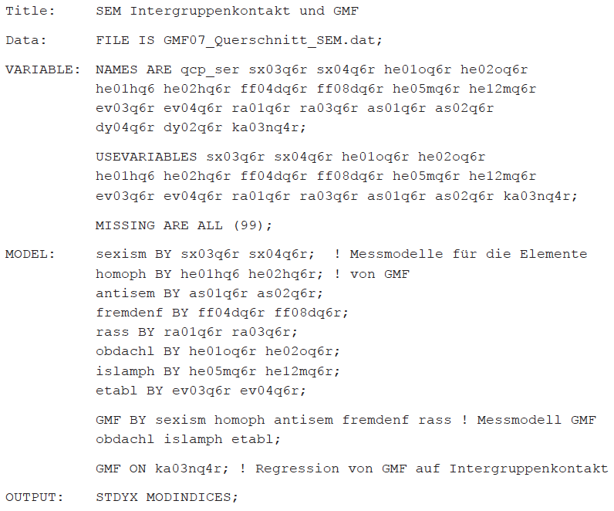
Structural Equation Model
Model 5. SEM
Code: M5, taken from Kleinke (et al 2017).

Slide 34
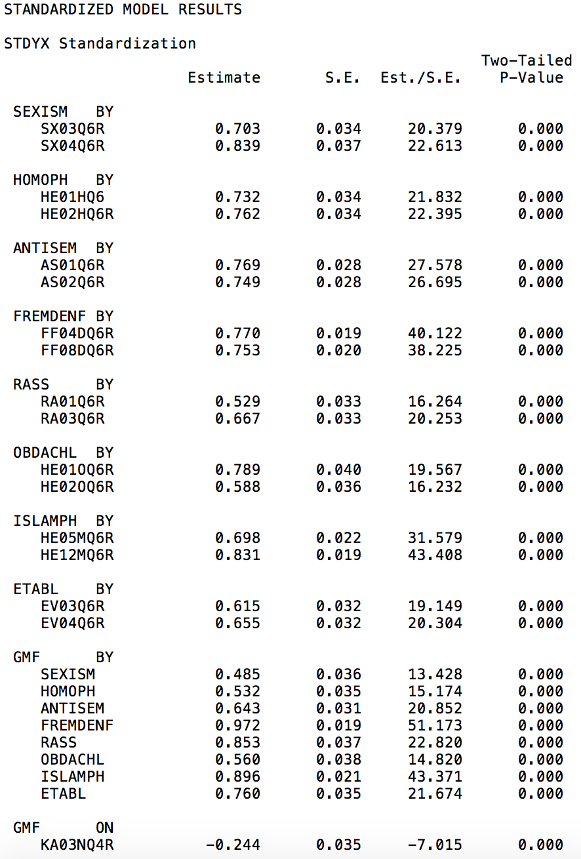
Structural Equation Model
Model 5. Full SEM – Measurement plus Path Model
Code: M5, taken from Kleinke (et al 2017).

Slide 35
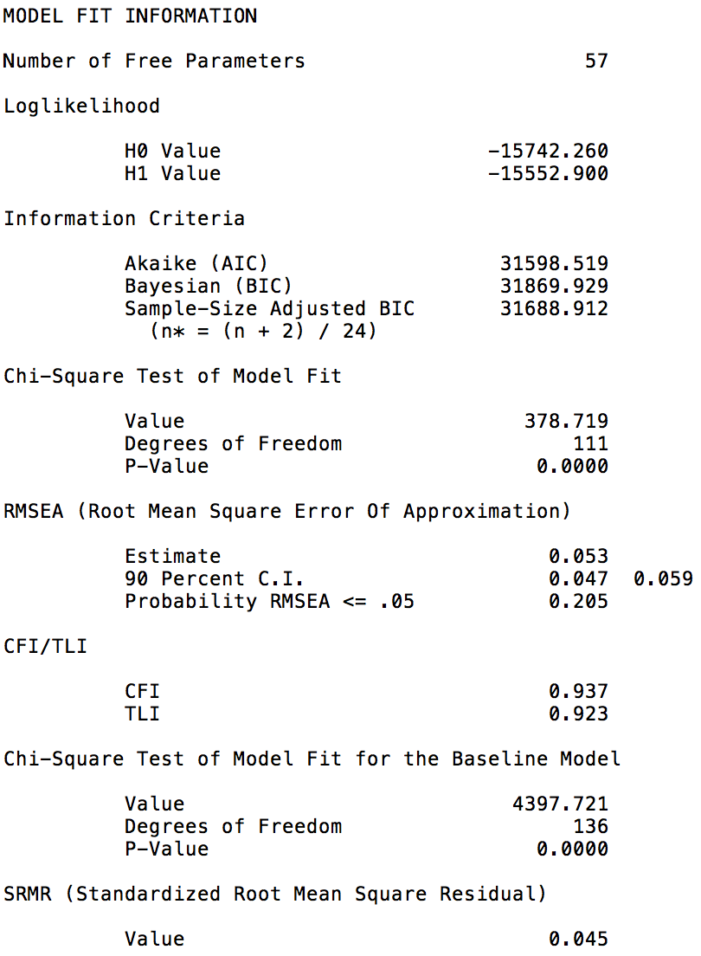
Structural Equation Model
Code: M5, taken from Kleinke (et al 2017).

Slide 36
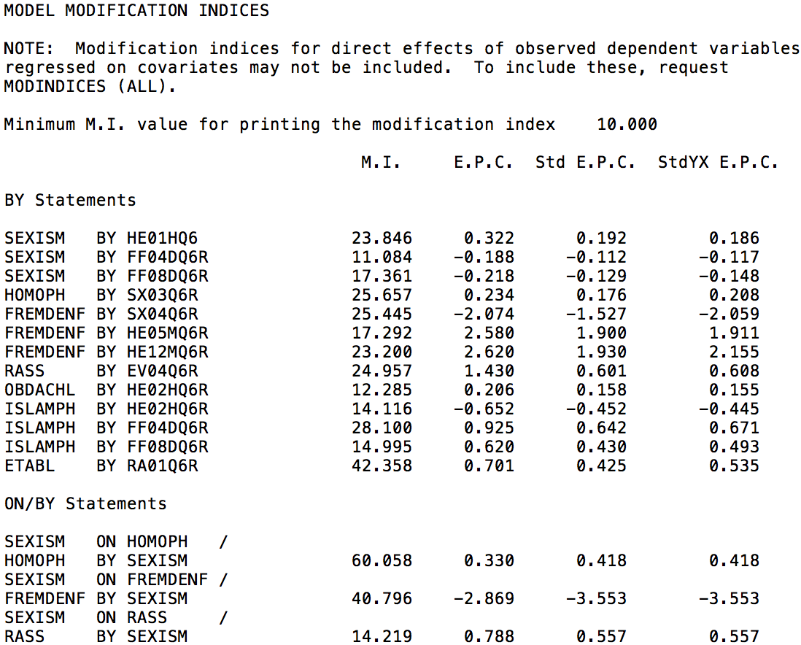
Structural Equation Model
Code: M5, taken from Kleinke (et al 2017).

Slide 37
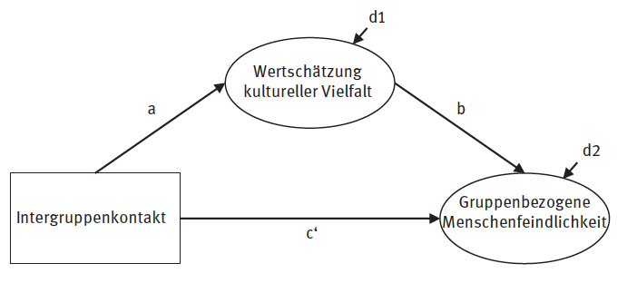
Mediation Model: Indirect and Direct Effects
Appreciation of cultural diversity
Intergroup contact
Group-focused enmity
(Kleinke et al 2017: Figure 3.2)

Slide 38
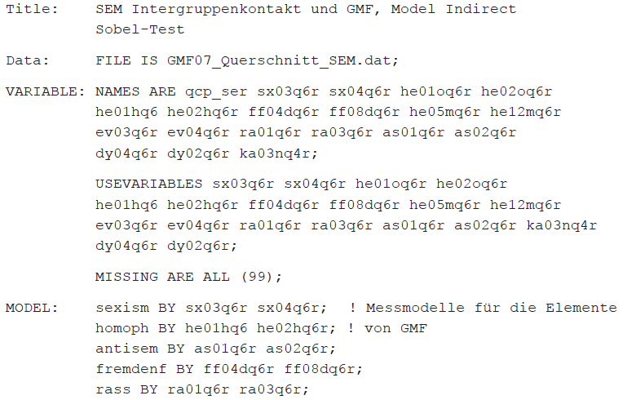
Mediation Model: Indirect and Direct Effects
Model 6. Direct and Indirect
Code: M6, taken from Kleinke (et al 2017).

Slide 39
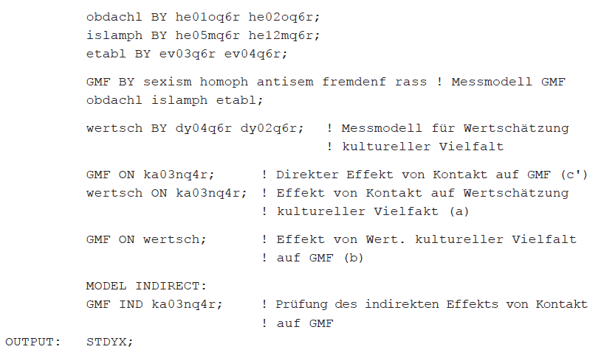
Mediation Model: Indirect and Direct Effects
Model 6
Code: M6, taken from Kleinke (et al 2017).

Slide 40
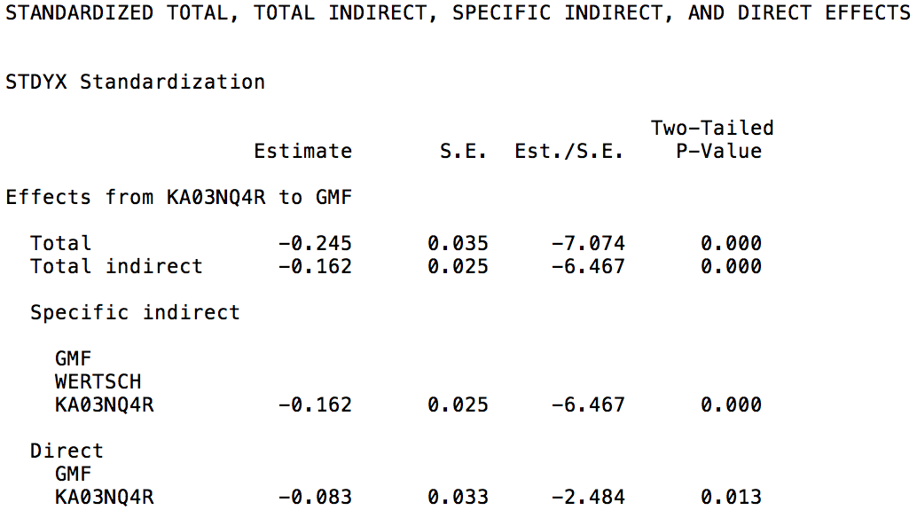
Mediation Model: Indirect and Direct Effects
Model 6. Direct and Indirect Effects
Code: M6, taken from Kleinke (et al 2017).

Slide 41
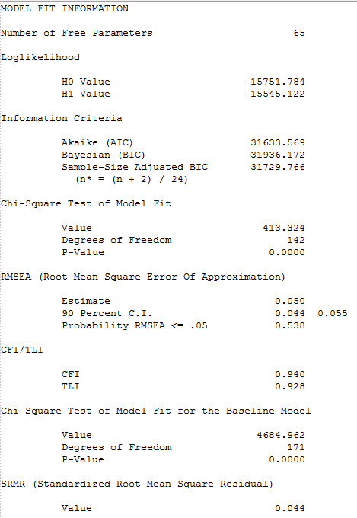
Model Fit
Model 7. Exact Fit Test. Fit Statistics for Mediation Model
Models must be nested for chi-square tests!
Code: M7, data from Kleinke (et al 2017).
(see Kline 2016; also easy to follow discussion from David A. Kenney http://davidakenny.net/cm/fit.htm)

Slide 42
Model Fit
Model 7. Exact Fit Test. Fit Statistics for Mediation Model
Code: M7, data from Kleinke (et al 2017).
(see Kline 2016; also easy to follow discussion from David A. Kenney http://davidakenny.net/cm/fit.htm)

Slide 43
Model Fit
Model 7. Exact Fit Test. Fit Statistics for Mediation Model
Chi-Square (χ²)
Degrees of Freedom
Significance – Tests whether this model fits the data worse than the baseline model. A significant p means it does not fit worse.
Code: M7, data from Kleinke (et al 2017).
(see Kline 2016; also easy to follow discussion from David A. Kenney http://davidakenny.net/cm/fit.htm)

Slide 44
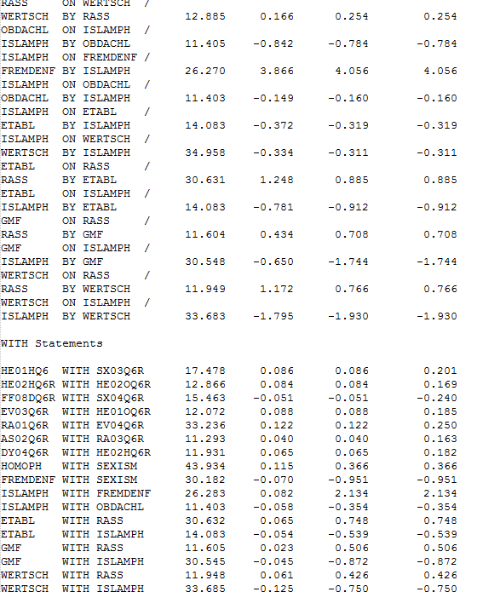
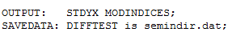
Model Fit
Model 7. Exact Fit Test. Fit Statistics for Mediation Model
Modification Indices (‘MODINDICES’)
Savedata: ‘DIFFTEST’
(for MLMV WLSMV)
Code: M7, data from Kleinke (et al 2017).

Slide 45
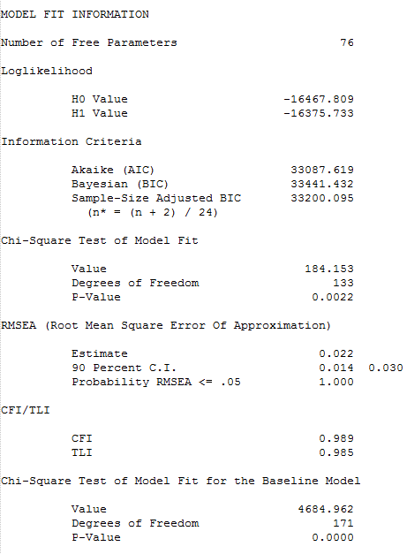
Model Fit
Model 8. Equal Fit Test after Modifications
Table 1. Excel Chi-Square Calculator

Slide 46
Model Fit
Model 8. Equal Fit Test after Modifications
Exact Fit Hypothesis:
That the tested model is significantly different from the baseline (p>0.05 rejects; supports tested model)
Equal Fit Hypothesis:
That the larger model (less df) is significantly better fitting than the smaller model (more df) (p>0.05 rejects; supports the smaller model)

Slide 47
Model Fit
Model 8. Equal Fit Test after Modifications
RMSEA:
Reviewer approved… <0.05
√(χ² - df)
__________
√[df(N - 1)]
(where df = Model df (i.e., “moments” or estimated “parameters”))
Note: Universal cutoffs are a ‘bad’ idea (Chen et al 2008)
(see Kline 2016; also easy to follow discussion from David A. Kenney http://davidakenny.net/cm/fit.htm)

Slide 48
Model Fit
Model 8. Equal Fit Test after Modifications
Paradigm Shift Looming…
or, Chi-square is THE ONLY global fit test one needs
“A telling anecdote in this regard comes from Dag Sorböm, a long-time collaborator of Karl Joreskög, one of the key pioneers of SEM and creator of the LISREL software package. In recounting a LISREL workshop that he jointly gave with Joreskög in 1985, Sorböm notes that, in his lecture Karl would say that the Chi-square is all you really need. One participant then asked ‘Why have you then added GFI [goodness-of-fit index]?’ Whereupon Karl answered ‘Well, users threaten us saying they would stop using LISREL if it always produces such large Chi-squares. So we had to invent something to make people happy. GFI serves that purpose’” (McIntosch 2012:10)
(see Kline 2016; also easy to follow discussion from David A. Kenney http://davidakenny.net/cm/fit.htm)

Slide 49
Non-Convergence
Identification?
Under-identified
See discussion of “counting rule” in Kline (2016:145)
Mplus identifies parameter problems
TECH 4 in Mplus
More iterations?
Start Values
Maximum Likelihood, depends on
*# …in Mplus
(var, init(#)) …in Stata

Slide 50
Thank You
Technical appendix with Stata syntax and a dictionary of SEM terms (still under construction)
Follow all hyperlinks in the slides, or find all examples in this folder
SEMNET, a vibrant listserv for SEM questions and discussion
Mplus discussion forum at www.statmodel.com

Slide 51
References
Bollen, Kenneth A. 1989. Structural Equations with Latent Variables. New York, NY: John Wiley & Sons.
Bollen, Kenneth A, and Judea Pearl. 2013. “Eight Myths about Causality and Structural Equation Models.” In Handbook of Causal Analysis for Social Research, ed. Stephen L. Morgan. Dordrecht, Netherlands: Springer Science & Business Media, 301–28.
Chen, Feinian, Patrick J. Curran, Kenneth A. Bollen, James Kirby, and Pamela Paxton. 2008. “An Empirical Evaluation of the Use of Fixed Cutoff Points in RMSEA Test Statistic in Structural Equation Models.” Sociological Methods & Research 36(4):462–94.
Kline, Rex B. 2016. Principles and Practice of Structural Equation Modeling. 4th Edition. New York and London: Guilford Press.
Kleinke, Kristian, Elmar Schlüter, and Oliver Christ. 2017. Strukturgleichungsmodelle Mit Mplus: Eine Praktische Einführung. Oldenburg: Walter de Gruyter.
McIntosh, Cameron N. 2012. “Improving the Evaluation of Model Fit in Confirmatory Factor Analysis: A Commentary on Gundy, C.M., Fayers, P.M., Groenvold, M., Petersen, M. Aa., Scott, N.W., Sprangers, M.A.J., Velikov, G., Aaronson, N.K. (2011). Comparing Higher-Order Models for the EORTC QLQ-C30. Quality of Life Research, doi:10.1007/s11136-011-0082-6.” Quality of Life Research 21(9):1619–21.

Slide 52
Further Reading
Hayduk, Leslie A. and H. Pazderka-Robinson. 2007. “Fighting to Understand the World Causally: Three Battles Connected to the Causal Implications of Structural Equation Models.” in Sage Handbook of Social Science Methodology, edited by W. Outhwaite and S. Turner. London: Sage Publications.
Hayduk, Leslie A., Greta Cummings, Kwame Boadu, Hannah Pazderka-Robinson, and Shelley Boulianne. 2007. “Testing! Testing! One, Two, Three – Testing the Theory in Structural Equation Models!” Personality and Individual Differences 42(5):841–50.
Hayduk, Leslie A. 2014. “Seeing Perfectly Fitting Factor Models That Are Causally Misspecified: Understanding That Close-Fitting Models Can Be Worse.” Educational and Psychological Measurement 74(6):905–26.

Slide 53
SEM History
Pearl, Judea. 2015. “Trygve Haavelmo and the Emergence of Causal Calculus.” Economic Theory 31:152–79.
Wright, Sewall. 1934. “The Method of Path Coefficients.” The Annals of Mathematical Statistics 5(3):161–215.

Slide 54
(Kleinke et al 2017)
v1
*
v2
v3
v4
v5
v6
v8
v9
v12
v13
v14
v15
v16
v17
v10
v11
v20
.
dy04q6r v18 – different cultures enrich German culture
dy02q6r v19 – appreciation of different cultures

Slide 55
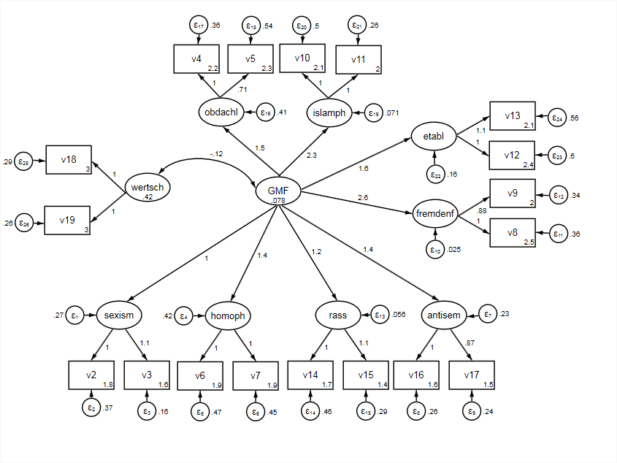
A Stata Example
Code: StataModel, or see Technical Appendix, data from Kleinke (et al 2017).

